Slide 1
Diffusion Model Guidance
Training/Finetuning
Classifier Guidance
Classifier-free Guidance
Conditional Diffusion
ControlNet
Training-Free
Fusing Diffusion Paths
Training-free Gradient Guidance
Attention-based Guidance
Energy-based Guidance

Slide 2
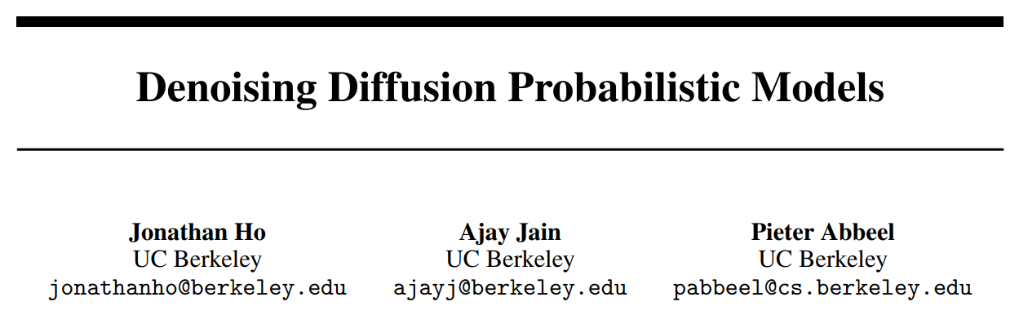
Diffusion Models
Code: https://github.com/hojonathanho/diffusion
Denoising Diffusion Probabilistic Models, Berkeley, NIPS 2020

Slide 3
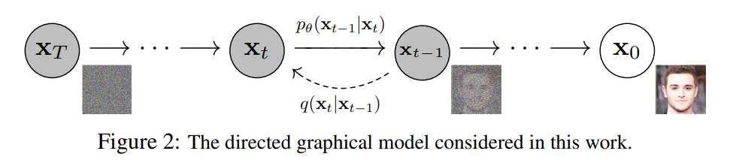
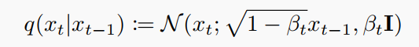
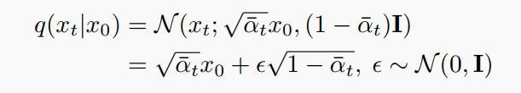
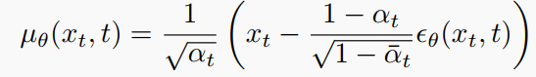
Diffusion Models
forward processes:
training objective:
Denoising Diffusion Probabilistic Models, Berkeley, NIPS 2020

Slide 4
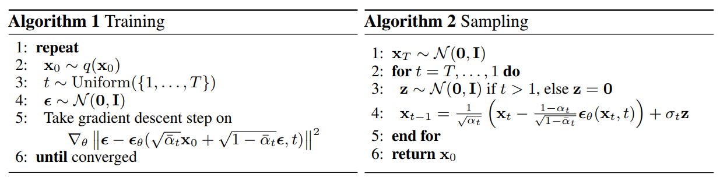
Diffusion Models
Denoising Diffusion Probabilistic Models, Berkeley, NIPS 2020

Slide 5
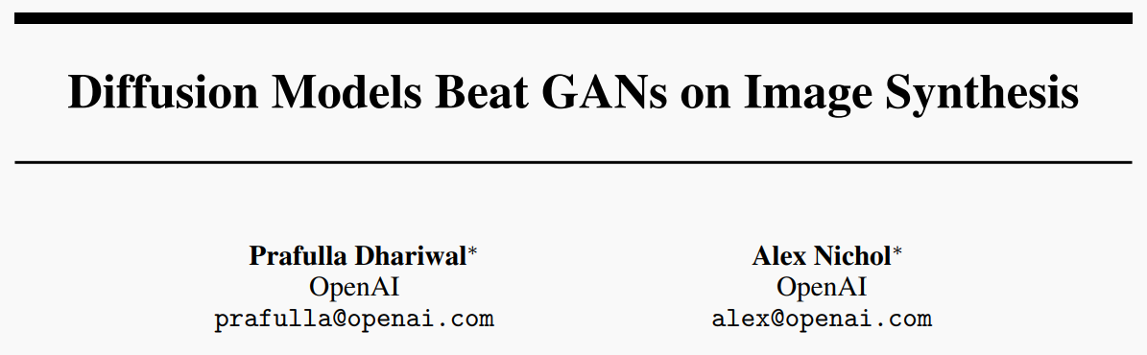
1. Classifier Guidance
Code: https://github.com/openai/guided-diffusion
Diffusion Models Beat GANs on Image Synthesis, OpenAI, NIPS 2021

Slide 6
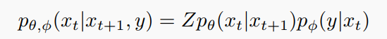
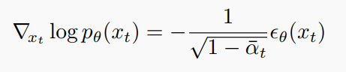
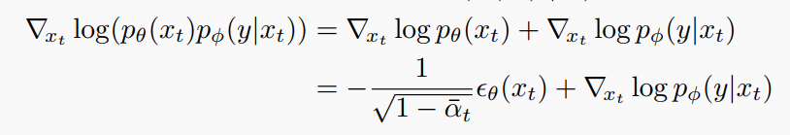
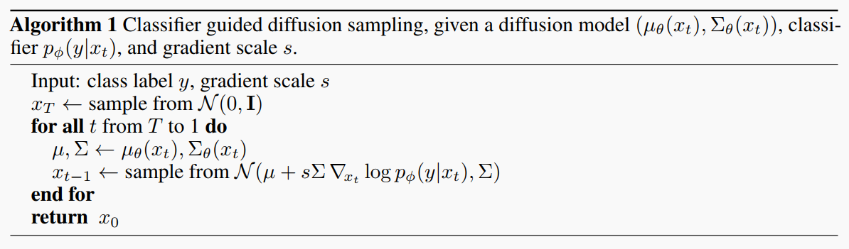
1. Classifier Guidance
Classifier Guidance
优点: 不需要对预训练的模型进行操作, 只需额外训练一个分类器.
缺点: 效果受classifer的影响较大, 特别是classifier需要处理的是不同尺度的噪声图像.
将unconditional转换成conditional, 本质是在建模条件分布
从score function的角度, 预测噪声本质是在得到数据分布的梯度
直观的做法就是, 额外训练一个分类器, 利用分类器对Denoising 过程中的梯度方向进行修正
Diffusion Models Beat GANs on Image Synthesis, OpenAI, NIPS 2021

Slide 7

2. Classifier-free Guidance
Code: no official code
Classifier-Free Diffusion Guidance, Google, NIPS 2021

Slide 8
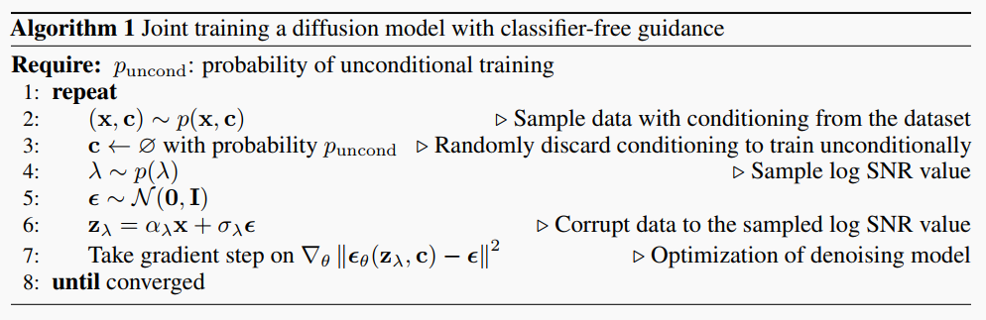
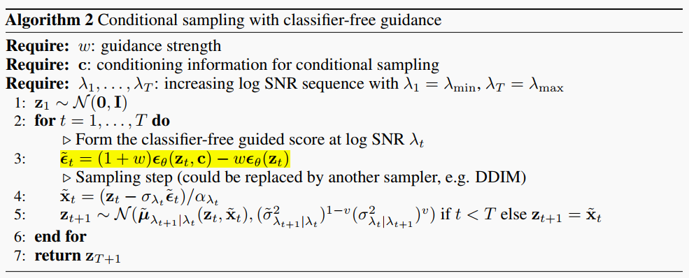
2. Classifier-free Guidance
Classifier-Free Guidance
优点:不需要额外训练分类器, 实现起来简单, 现在的扩散模型基本都在用
缺点: 需要在训练的时候同时训练有条件和无条件两种情况
直观的做法就是在训练的时候同时训练有条件和无条件两种情况, 无条件的输入用null token代替
采样的时候增强条件方向, 减弱无条件的方向
Classifier-Free Diffusion Guidance, Google, NIPS 2021

Slide 9
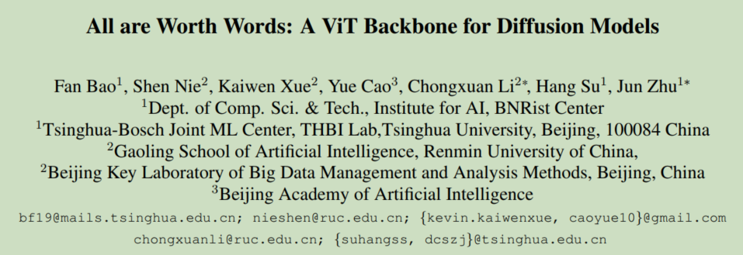
3. Conditional Diffusion
Code: https://github.com/baofff/U-ViT
All are Worth Words: A ViT Backbone for Diffusion Models, CVPR2023, Tsinghua University

Slide 10
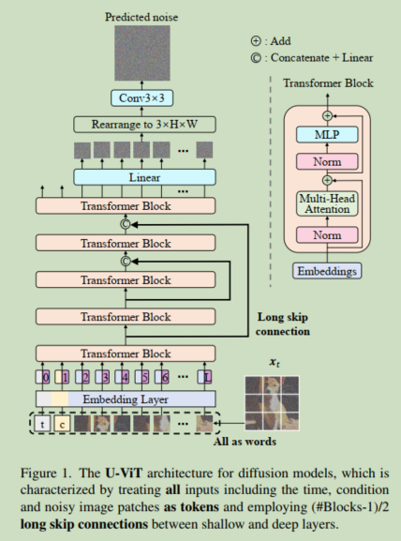
3. Conditional Diffusion
Class condition通过token concat加入
Text condition 通过cross-attention加入
Combine the long skip branch: concatenating them and then performing a linear projection (Linear(Concat(hm, hs)))
feed the time into the network:
Treat it as a token
add an extra convolutional block after the transformer:
After the linear projection
the patch embedding:
maps a patch to a token embedding
position embedding:
1-dimensional learnable position embedding
All are Worth Words: A ViT Backbone for Diffusion Models, CVPR2023, Tsinghua University

Slide 11
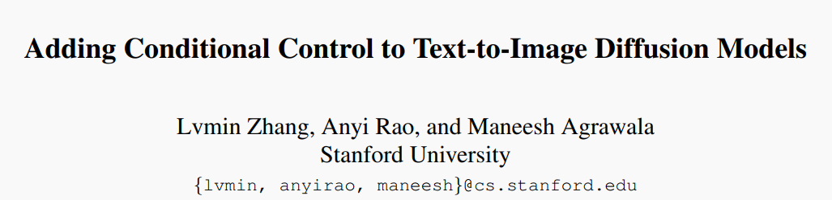
4. ControlNet
Code: https://github.com/lllyasviel/ControlNet
Adding Conditional Control to Text-to-Image Diffusion Models, Stanford, ICCV2023

Slide 12
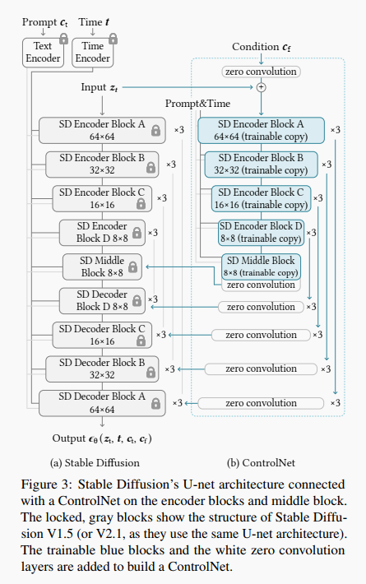
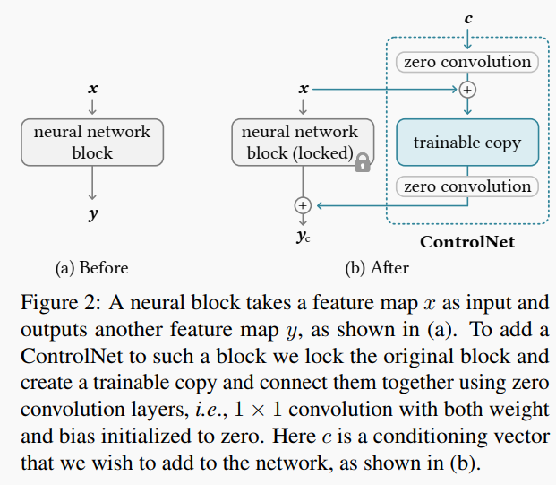
4. ControlNet
整体分成两个部分, 原始Stable Diffusion参数冻结, 复制一份其encoder的参数作为ControlNet对特定的条件输入进行微调. ControlNet和原始Stable Diffusion通过Zero-conv之后相加进行连接.
可用于边界图,分割图,human pose等多种模态的输入
ControlNet
优点:可以处理多模态的输入条件
缺点: 需要训练ControlNet
Adding Conditional Control to Text-to-Image Diffusion Models, Stanford, ICCV2023

Slide 13
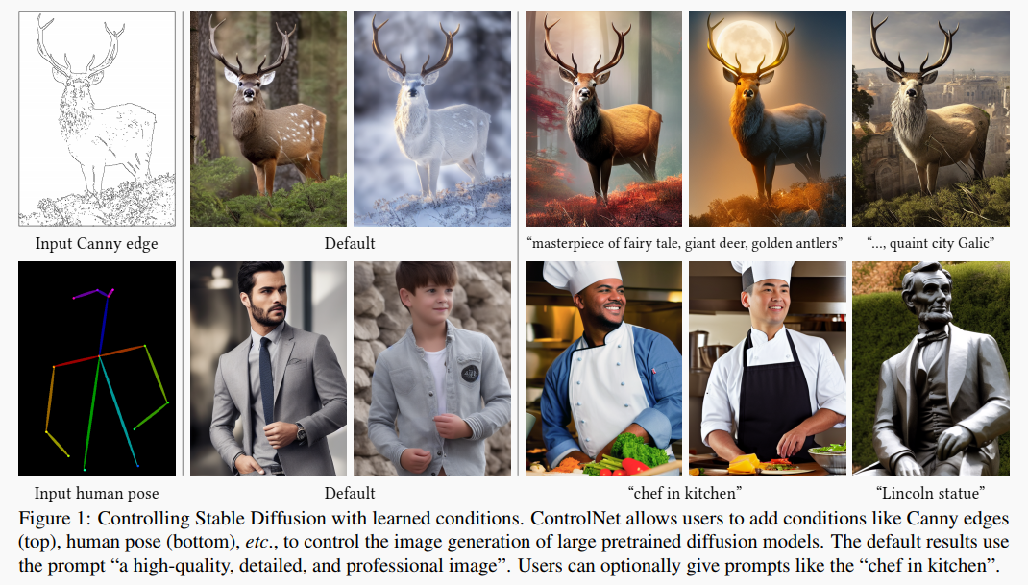
4. ControlNet
Adding Conditional Control to Text-to-Image Diffusion Models, Stanford, ICCV2023

Slide 14
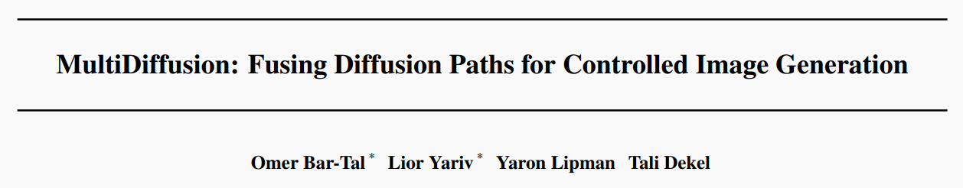
5. Fusing Diffusion Paths
Code: https://github.com/omerbt/MultiDiffusion
MultiDiffusion: Fusing Diffusion Paths for Controlled Image Generation, ICML2023, Weizmann Institute of Science

Slide 15
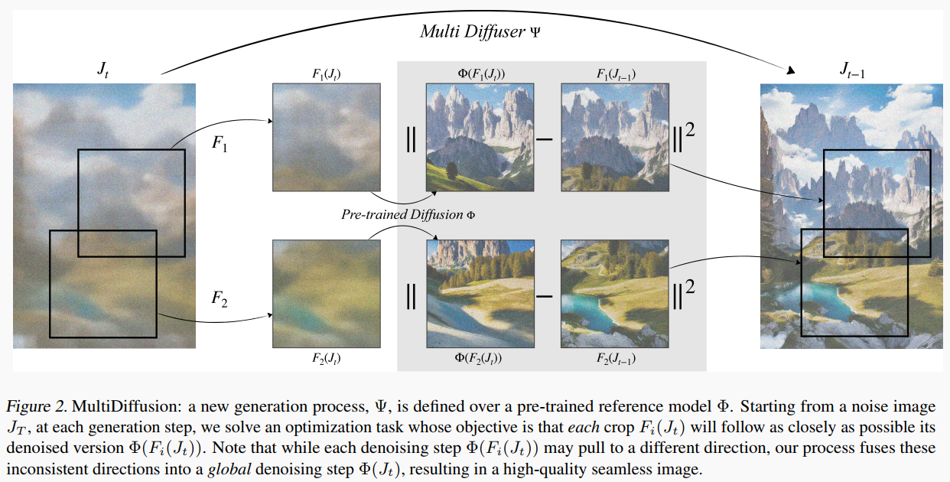
5. Fusing Diffusion Paths
没看太明白, 但是思想值得借鉴
原始的Diffusion有一个采样的空间, 现在定义一个可逆转换F, 在转换后的空间做fusion, 同时保证fusion后的结果在原始空间的一致性
MultiDiffusion: Fusing Diffusion Paths for Controlled Image Generation, ICML2023, Weizmann Institute of Science

Slide 16
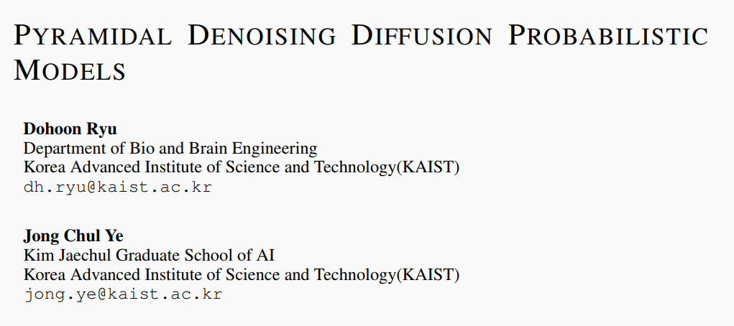
6. Training-Free Gradient Guidance
Code: no official code
Pyramidal Denoising Diffusion Probabilistic Models, Arxiv202209, KAIST

Slide 17
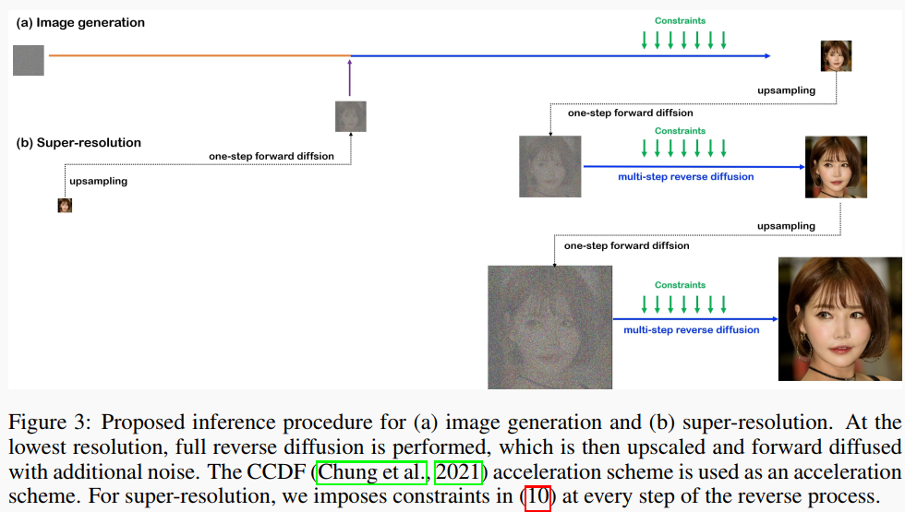
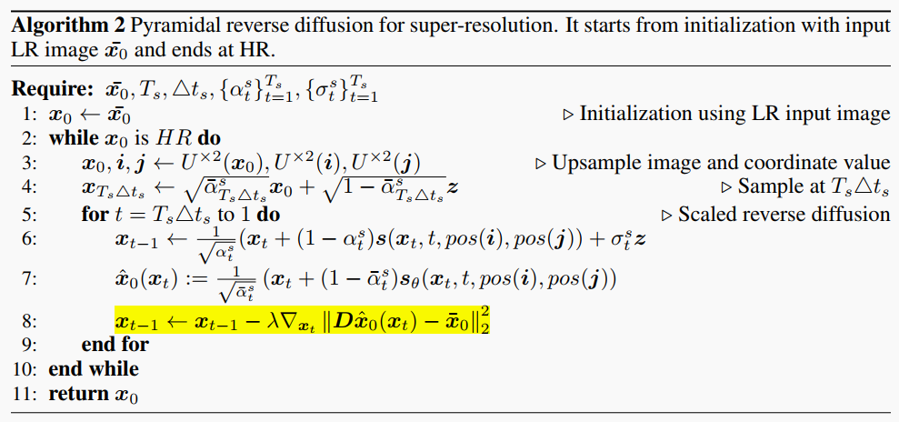
6. Training-Free Gradient Guidance
多尺度扩散模型用于super-resolution, 通过对于每一步预测的真实图与低分辨率图的差值的梯度进行引导
Pyramidal Denoising Diffusion Probabilistic Models, Arxiv202209, KAIST

Slide 18
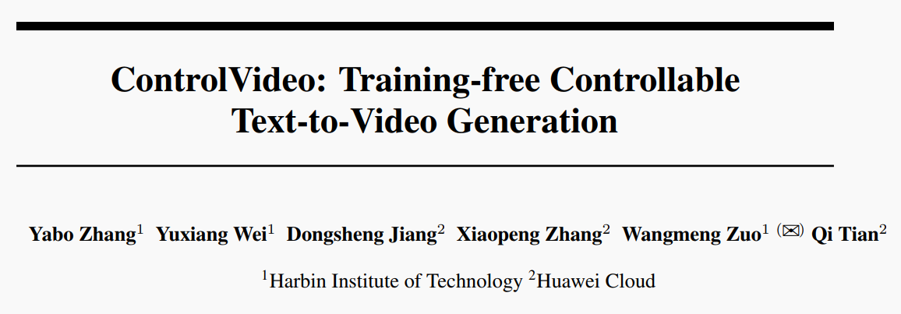
7. Attention-Based Guidance
Code: https://github.com/YBYBZhang/ControlVideo
ControlVideo: Training-free Controllable Text-to-Video Generation, ICLR2024, Harbin Institute of Technology

Slide 19
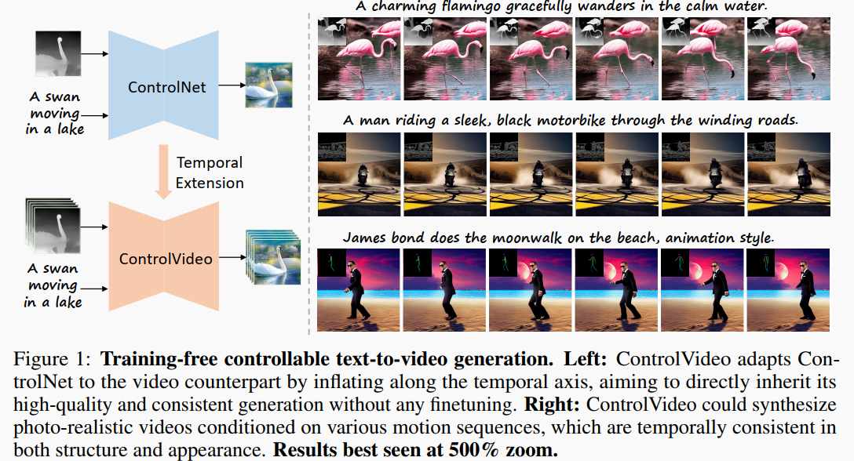
7. Attention-Based Guidance
Cross-frame attention
Pyramidal Denoising Diffusion Probabilistic Models, Arxiv202209, KAIST

Slide 20
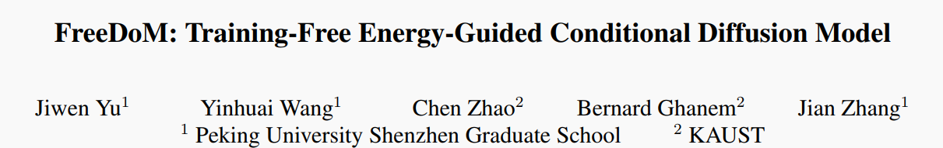
8. Energy-Based Guidance
Code: https://github.com/vvictoryuki/FreeDoM
FreeDoM: Training-Free Energy-Guided Conditional Diffusion Model, ICCV2023, Peking University Shenzhen Graduate School

Slide 21
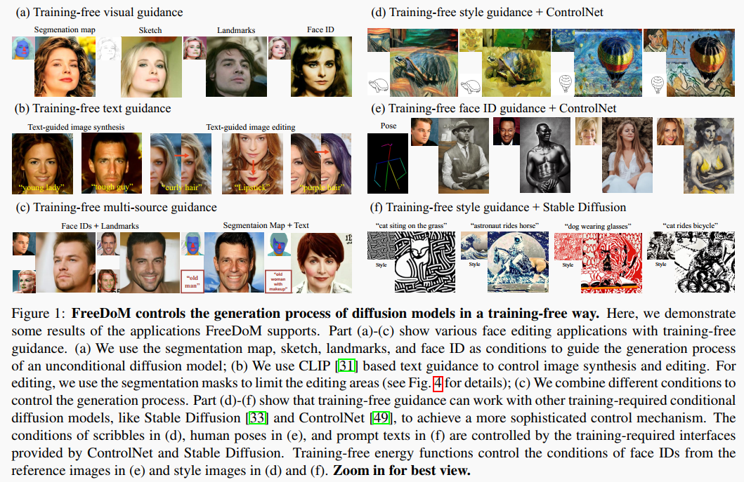
8. Energy-Based Guidance
FreeDoM: Training-Free Energy-Guided Conditional Diffusion Model, ICCV2023, Peking University Shenzhen Graduate School

Slide 22
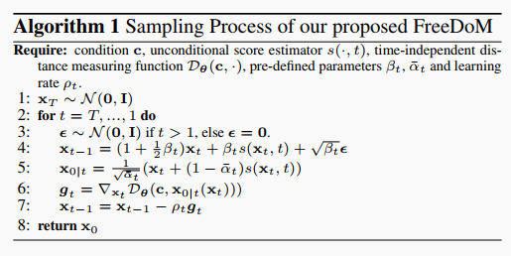
8. Energy-Based Guidance
与Classifier-Guidance的区别在于, CG的分类器是对不同尺度的噪声图像进行操作, 而本文方法是对每步预测得到的x_0做操作
这个给基于x_0的Guidance奠定了理论的基础, 推导过程还需要仔细再看一下, 比较有用.
FreeDoM: Training-Free Energy-Guided Conditional Diffusion Model, ICCV2023, Peking University Shenzhen Graduate School

